Slide 1
TOPIC A:
DATABASES
LESSON A-8
ENTITY RELATIONSHIP DIAGRAMS

Slide 2
AGENDA
Warm-up Question
Entity Relationship Diagrams
Modality
Cardinality
NOTE!
Have a way to take notes available for this lesson

Slide 3

THE WARM UP QUESTION
A hospital database needs to track patients’ allergies.
Should this be stored as a Boolean (Yes/No), a String (list of allergens), or a separate linked table?
Which choice would best meet the needs of doctors, patients, and administrators and why?

Slide 4
THE WARM UP ANSWER
I would recommend a separate linked table
This way, each individual allergen can be accounted for on a per-patient basis
This would be easily searchable by doctors trying to check which medications or food somebody can have
This will, unfortunately, likely take more time to input than the Boolean or string however

Slide 5
ENTITY RELATIONSHIP DIAGRAMS
An Entity Relationship Diagram (ERD) is a visual representation of the entities in a database and the relationship between them
Customers
Products
1 customer places 1 or more orders
1 order has 1 or more products
Orders

Slide 6
ENTITY RELATIONSHIP DIAGRAMS
ERDs provide a lot of functionality
Clear overview of database structure
Easy to communicate with stakeholders about
Documentation for the database design
Support future development and maintenance
Define relationships to ensure data integrity and consistency

Slide 7
MODALITY
Think about the relationship between hospital patients and their medical records?
Does a patient have to have medical records to be in the hospitals database?

Slide 8
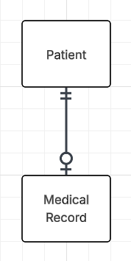
MODALITY
There are instances where a patient may not have medical records at a hospital
A new patient at the hospital
A baby that was just born
This means that the patient’s medical record is an optional relationship (0)

Slide 9
MODALITY
Now, let’s think about the relationship between a customer and an order on an online store like Amazon
Is there any instance where an order can be made without a customer account?

Slide 10
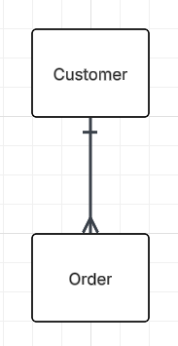
MODALITY
In this case, you are prevented from making an order unless you sign up for an account
So, we would say that every order must be associated with a customer
This is a mandatory relationship (1)

Slide 11
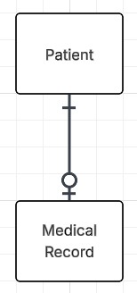
MODALITY
The distinction between the mandatory and optional relationships is called modality

Slide 12
CARDINALITY
Consider the relationship between students and clubs
How many students can be in one club?
How many clubs can a student be in?
How many students must a club have to exist?
Does a student have to be in a club to exist?

Slide 13
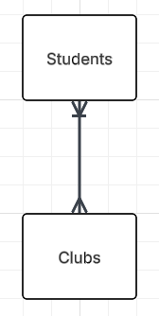
CARDINALITY
We would say that a club can have many students
We would say that a student may join many clubs
A club has to have one or more students to exist (mandatory relationship modality)
A student does not have to be in any clubs (optional relationship modality)
This creates a many to many relationship between students and clubs

Slide 14
CARDINALITY
Revisiting our hospital and patient record ERD, what is the relationship between those tables?

Slide 15
CARDINALITY
Because each patient only has one medical record, and each medical record goes to one patient…
We have a one-to-one relationship

Slide 16
CARDINALITY
Cardinality refers to the maximum number of times an entity can be associated with instances in a related entity
One to One
One to Many
Many to Many

Slide 17
CARDINALITY
Categorize the following relationships as One to One, One to Many, or Many to Many:
Person & Passport
Teacher & Students
Author & Books
Movies & Actors
Products & Orders
Car & License Plate
Department & Employees
User & Profile Settings

Slide 18
CARDINALITY
Categorize the following relationships as One to One, One to Many, or Many to Many:
Person & Passport
Teacher & Students
Author & Books
Movies & Actors
Products & Orders
Car & License Plate
Department & Employees
User & Profile Settings

Slide 19
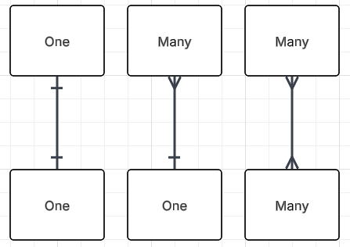
ER DIAGRAM SYMBOLS
When referring to cardinality, we use the following symbols in an ERD
Single line for One
Crow’s foot for Many

Slide 20
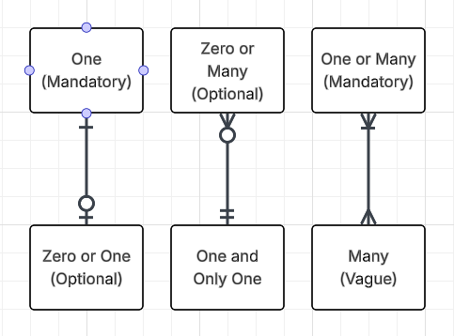
ER DIAGRAM SYMBOLS
We then add modality on top of this
A 0 for an optional relationship, and a line for a required relationship

Slide 21
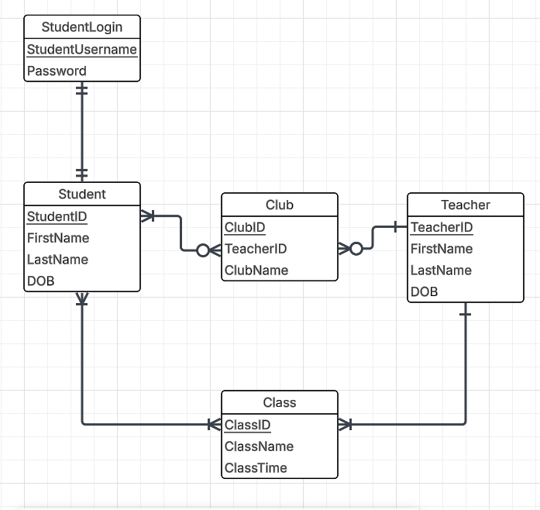
ER DIAGRAM SYMBOLS
To fully flesh out our ERDs, we need to add the attributes of each table so it’s a more helpful overview of the database
Underline Primary Keys
Check the example below

Slide 22
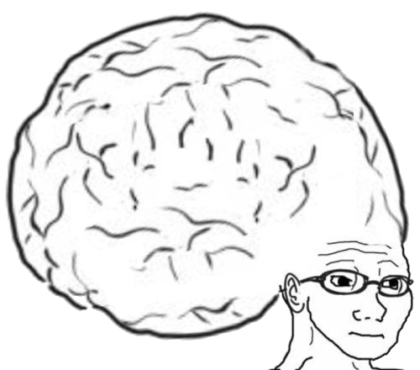
VOCAB TO REMEMBER
Many to Many Relationship
One to One Relationship
One to Many Relationship
Cardinality
Modality
Entity Relationship Diagram
Optional Relationship
Required Relationship

